Slide 1

SECD2523 DATABASE
TOPIC 1 | INTRODUCTION TO DATABASE
Content adapted from Connolly, T., Begg, C., 2015. Database Systems: A Practical Approach to Design, Implementation, and Management, Global Edition. Pearson Education.

Slide 2
LECTURE LEARNING OUTCOME
By the end of this lecture, students should be able to:
01
Common uses of database systems (DB).
02
Characteristics, problems and differences between file-based approach and DB approach.
03
Meaning of terms: DB, Database Management System (DBMS), DB application system, DB system.
04
Personnel involved in the DBMS environment.
05
Advantages and disadvantages of DBMS.
06
Three-level ANSI-SPARC architecture.

Slide 3
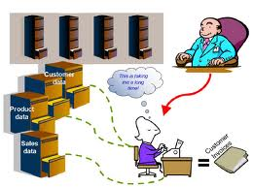
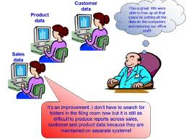
Before computer
After computer

Slide 4
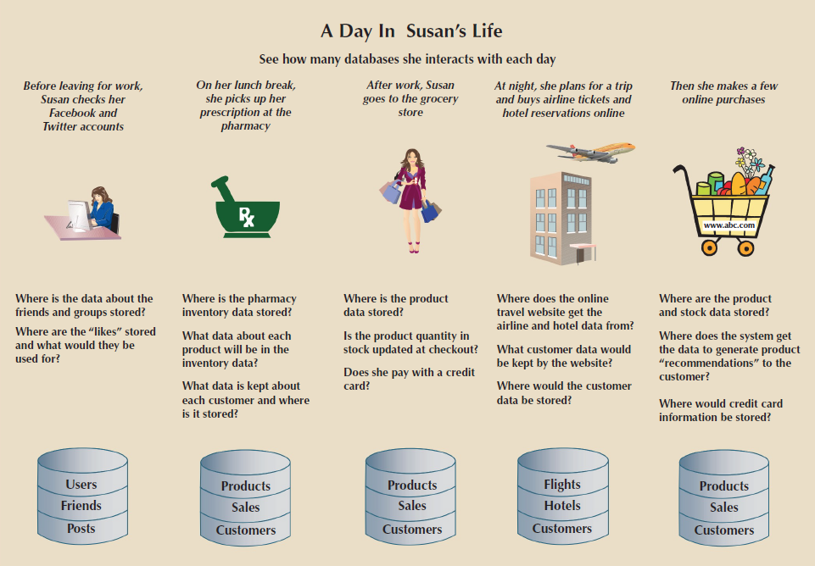
Introduction
Source: Coronel, 2019
Database is now such an integral part of our day-to-day life that often we are not aware we are using one.

Slide 5
Introduction
Some of the terminologies in this topic:
Terms | Description
Database | A collection of related data.
Database Management System (DBMS) | The software that manages & controls access to the database.
Database application | A program that interacts with the database at some point in its execution.
Database system | A collection of application programs that interact with the database along with the DBMS and database itself.

Slide 6
Traditional File-based System
An early attempt to computerize the manual filing system.
Definition:
  Collection of application programs that perform services for the end users (e.g.: reports). Each program defines and manages its own data.
Works well while the number of items to be stored is small. However, it breaks down when we need to cross-reference or process the information in the files.

Slide 7
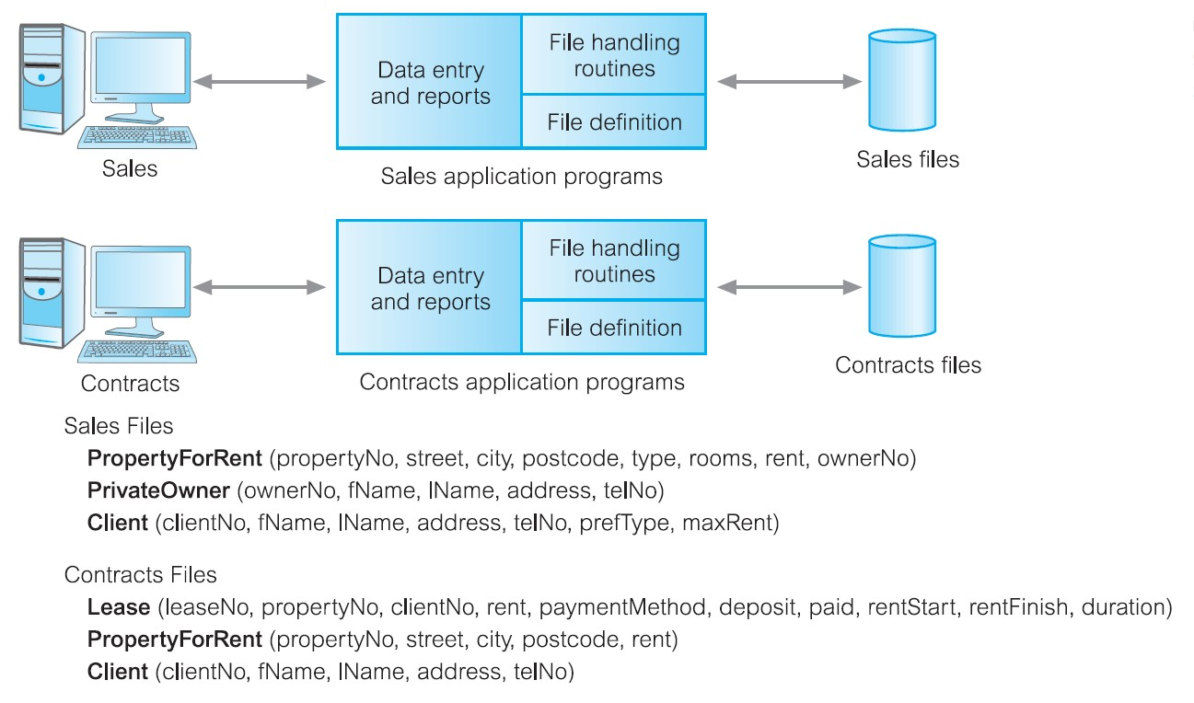
File-based Processing

Slide 8
File-based Processing
Figure shows each department accessing their own files through application programs written specially for them.
Each set of departmental application programs handles data entry, file maintenance, and the generation of a fixed set of specific reports.
The physical structure & storage of the data files and records are defined in the application code

Slide 9
Limitations of File-based Approach
Separation and isolation of data
  Each program maintains its own set of data.
  Users of one program may be unaware of potentially useful data held by other programs.
Duplication of data
  Same data is held by different programs.
  Wasted space and potentially different values and/or different formats for the same item.

Slide 10
Limitations of File-based Approach
Data dependence
  File structure (for data file) is defined in the program code.
  Changes to an existing structure are difficult to make
Incompatible file formats
  Programs are written in different languages, and so cannot easily access each other’s files.
Fixed Queries/Proliferation of application programs
  Programs are written to satisfy specific functions.
  Any new requirement needs a new program.

Slide 11
Database Approach
The limitations of the file-based approach can be attributed to 2 factors:
  Definition of data was embedded in application programs, rather than being stored separately and independently.
  No control over access and manipulation of data beyond that imposed by application programs.
Result, a new approach was required:-
  the database and Database Management System (DBMS).

Slide 12
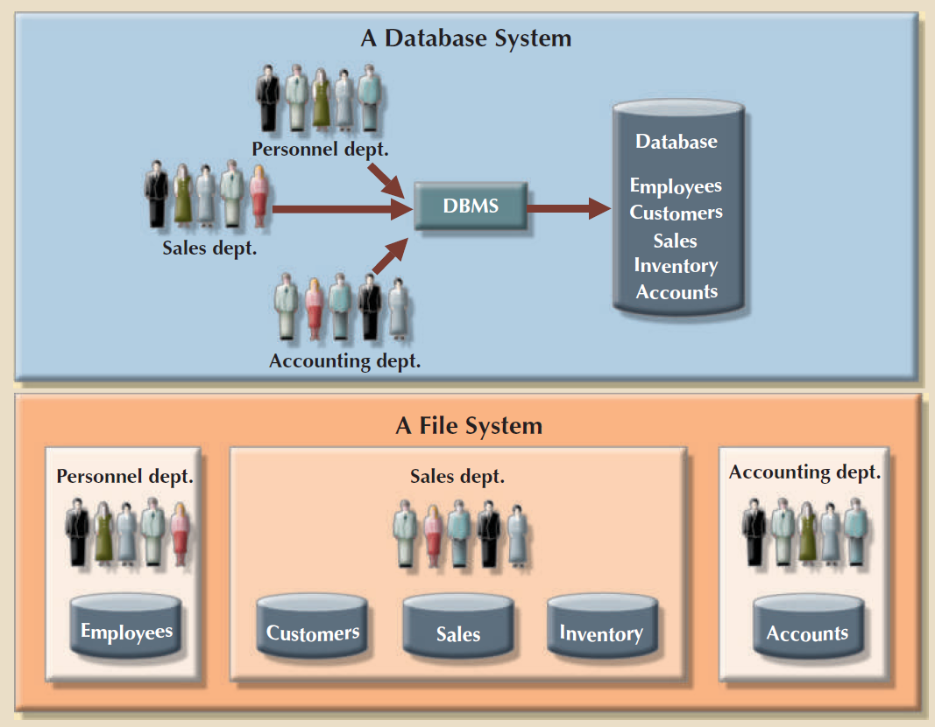
Contrasting File-based Approach and Database Approach
Source: Coronel, 2019

Slide 13




Overview of DB System
Database system
DBMS
DB
Users
DB Applications

Slide 14
The Database
Definition:
  Shared collection of logically related data (and a description of this data), designed to meet the information needs of an organization.
A database is also defined as a self-describing collection of integrated records
  The description of the data is known as the system catalogue (metadata) to enable program–data independence.
  The definition of data is separated from the application program.
  The users of an object only see the external definition and unaware of how the object is defined and how it functioned
Logically related data comprises entities, attributes, and relationships of an organization’s information.

Slide 15
Database Management System (DBMS)
DBMS is the software that interacts with the user’s application programs and the database
Definition: A software system that enables users to define, create, and maintain the database and that provides controlled access to this database.
  Define 🡪 using Data Definition Language (DDL)
  Create 🡪 insert, update, delete & retrieve data using Data Manipulation Language (DML)
  Controlled accessed 🡪 security, integrity, concurrency control, recovery & user-accessible catalog
Example of DBMS – Microsoft Access, Microsoft SQL Server, Oracle, Sybase, MongoDB, CouchDB and etc.

Slide 16
Database Management System (DBMS)
Data definition language (DDL).
  Permits specification of data types, structures and any data constraints.
  All specifications are stored in the database.
Data manipulation language (DML).
  General enquiry facility (query language) of the data.
  Using Structured Query Language (SQL) to produce required information.-

Slide 17
Database Application Programs
Definition of (Database) Application Program
  A computer program that interacts with the database by issuing an appropriate request (typically an SQL statement) to the DBMS
Users interact with the database through several application programs (used to create & maintain the database & to generate information) 🡪 written in some programming language

Slide 18
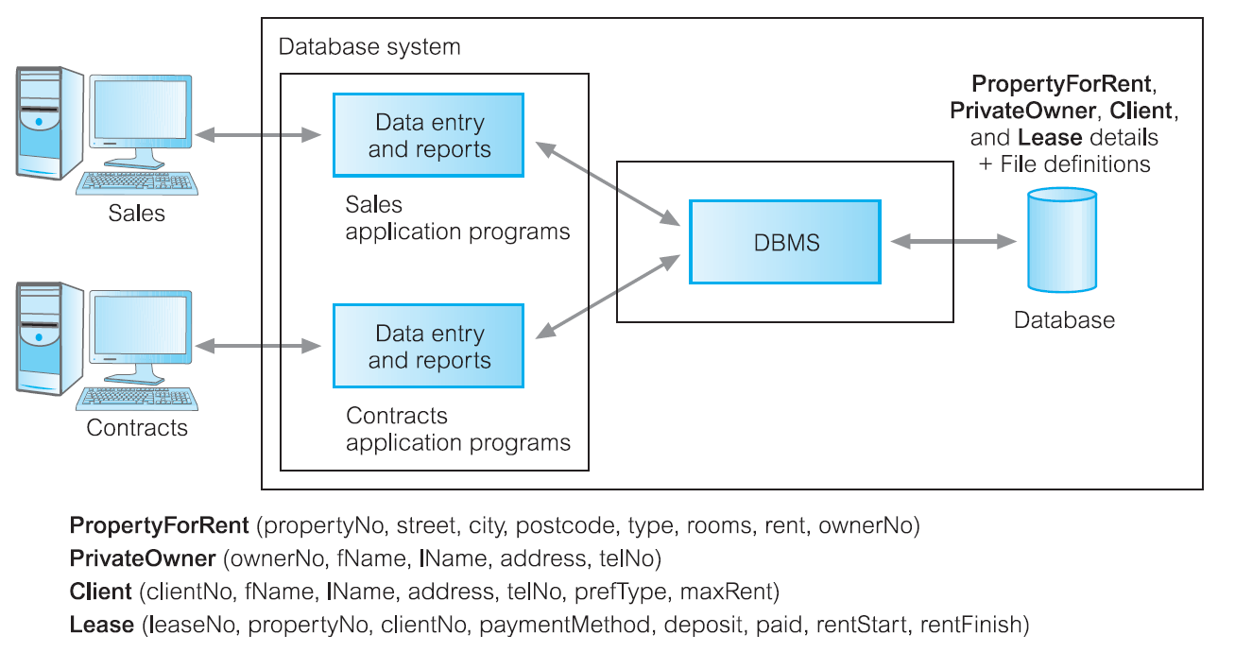
Database Application Programs
DB Applications

Slide 19
Database Application Programs
Figure shows each department using their application programs to access the database through the DBMS.
  Each set of departmental application programs handles data entry, file maintenance, and the generation of a fixed set of specific reports.
  The physical structure & storage of the data are now managed by the DBMS
A view mechanism.
  Provides users with only the data they want or need to use.

Slide 20
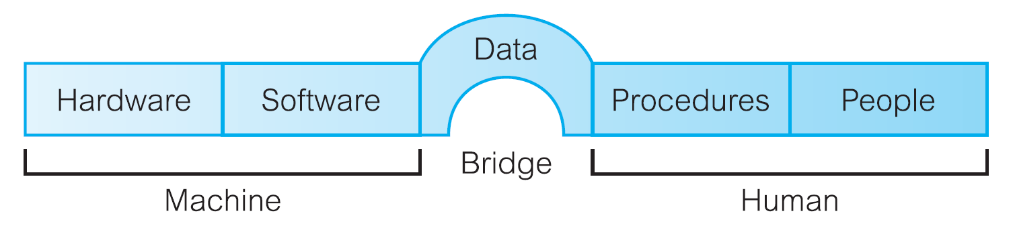
Components of DBMS Environment

Slide 21
Roles in the Database Environment
Data Administrator (DA)
  responsible for the management of the data resource
    Database planning
    Development and maintenance of standards, policies, procedures
    Conceptual/logical database design
Database Administrator (DBA)
  responsible for the physical realization of the database
    Physical database design and implementation
    Security & integrity control
    Maintenance of operational control
    Ensuring satisfactory performance of applications for users

Slide 22
Roles in the Database Environment
Database Designers (Logical and Physical)
  Logical : is concerned with identifying the data, the relationships between the data, & the constraint on the data that is to be stored in the database
  Physical : decides how the logical database design is to be physically realized
Application Programmers
  build the application programs that provide the required functionality for the end-users
End Users
  naive and sophisticated

Slide 23
File-based Approach
Limitation of File Based Approach :
Separation and isolation of data
Duplication of data
Data dependence
Incompatible file formats
Fixed Queries/Proliferation of application programs
Database Approach
Advantages of Database Approach :
Control of data redundancy
Data consistency
More information from the same amount of data
Sharing of data
Improved data integrity & security
Improved data accessibility and responsiveness
Increased productivity
Improved maintenance through data independence
Increased concurrency
Improved backup and recovery services
Disadvantage of Database Approach :
Complexity
Size
Cost of DBMSs
Additional hardware costs
Cost of conversion
Performance
Greater impact of a failure

Slide 24
Three-Level Architecture
All DBMS are built based on the 3-Level Architecture
All users should be able to access same data.
A user’s view is immune to changes made in other views.
Users should not need to know physical database storage details.

Slide 25
Three-Level Architecture
DBA should be able to change database storage structures without affecting the users’ views.
Internal structure of database should be unaffected by changes to physical aspects of storage.
DBA should be able to change conceptual structure of database without affecting all users.

Slide 26
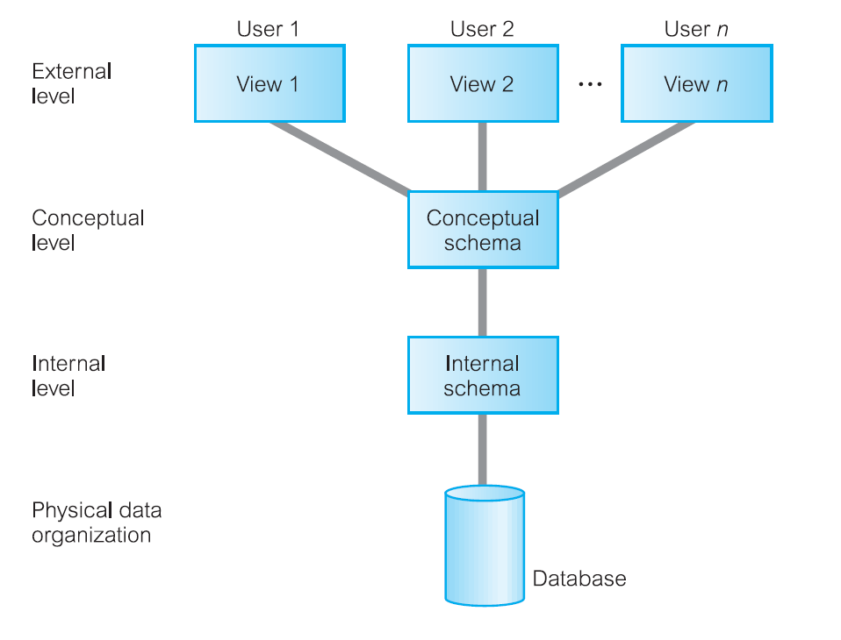
ANSI-SPARC Three-Level Architecture

Slide 27
ANSI-SPARC Three-Level Architecture
External Level
  Users’ views of the database.
  Describes that part of database that is relevant to a particular user.
Conceptual Level
  Community view of the database.
  Describes what data is stored in database and relationships among the data.

Slide 28
ANSI-SPARC Three-Level Architecture
Internal Level
  Physical representation of the database on the computer.
  Describes how the data is stored in the database.

Slide 29
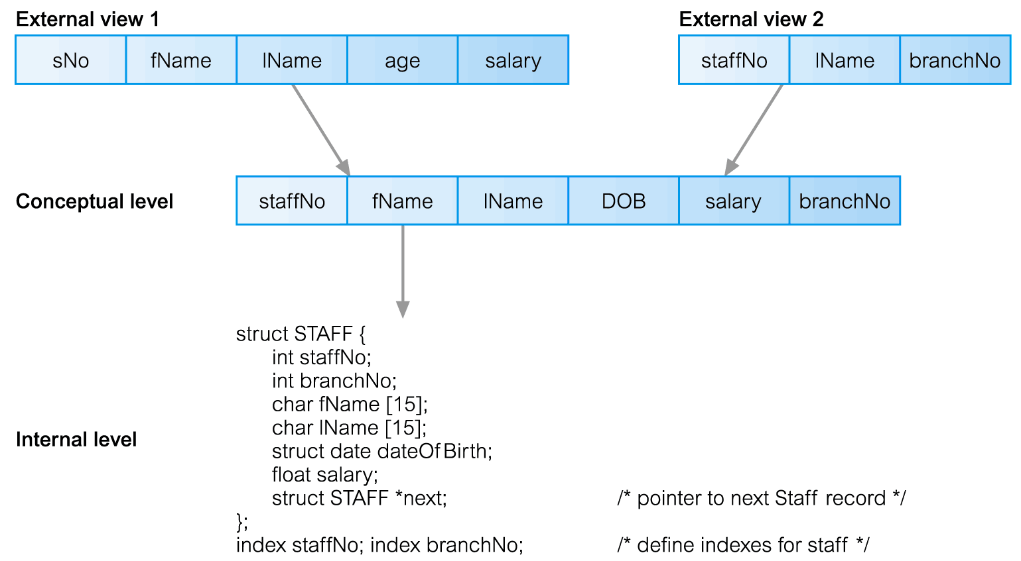
Differences between the three levels

Slide 30
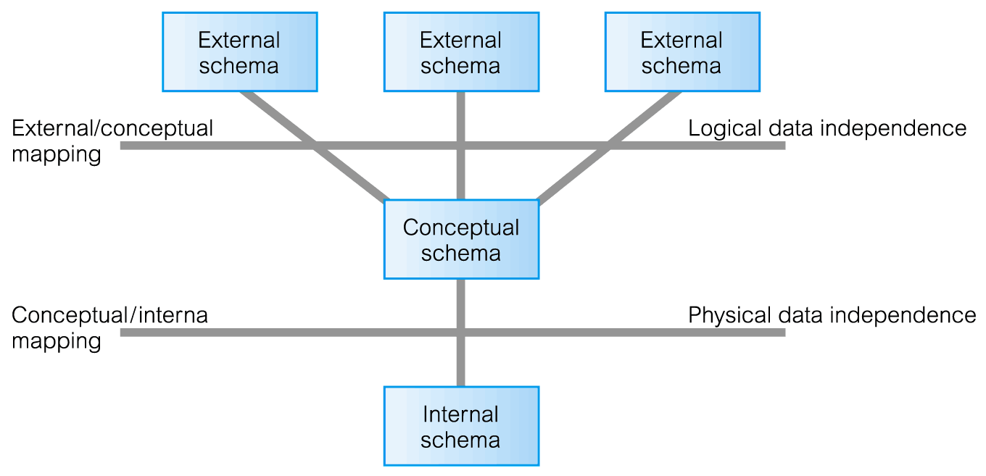
Data Independence and the ANSI-SPARC Three-Level Architecture

Slide 31
Data Independence
Referring to mapping between external, conceptual & internal levels
Logical Data Independence
  The immunity of external schemas to changes in conceptual schema.
  Conceptual schema changes (e.g. addition/ removal of entities).
    Should not require changes to external schema or rewrites of application programs.

Slide 32
Data Independence
Physical Data Independence
  The immunity of conceptual schema to changes in the internal schema.
  Internal schema changes (e.g. using different file organizations, storage structures/ devices).
    Should not require change to conceptual or external schemas.

Slide 33
Summary
Importance of databases
  Database approach VS file-based approach
Important terms in database fields
  Database, database applications, database systems, DBMS
Database architectures – ANSI-SPARC levels and associations with data independence

Slide 34


